Slide 1
Time Value of Money

Slide 2
CONTENTS
Single payment series compound amount
Single payment series present worth
Equal Payment Series (Derivation)
Equal Payment Series Compound Amount factor (F/A)

Slide 3
Cash flow patterns
Single payment
Uniform payment/ Equal payment
Linear Gradient series

Slide 4
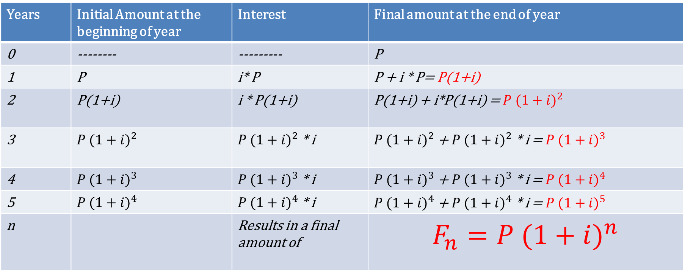
Compound Interest
Years | Initial Amount at the beginning of year | Interest | Final amount at the end of year
0 | -------- | --------- | P
1 | P | i* P | P + i * P= P(1+i)
2 | P(1+i) | i * P(1+i) | P(1+i) + i*P(1+i) = $P {(1+i)}^{2}$
3 | $$P {(1+i)}^{2}$$ | $P {(1+i)}^{2}$ * i | $P {(1+i)}^{2}$ + $P {(1+i)}^{2}$ * i = $P {(1+i)}^{3}$
4 | $$P {(1+i)}^{3}$$ | $P {(1+i)}^{3}$ * i | $P {(1+i)}^{3}$ + $P {(1+i)}^{3}$ * i = $P {(1+i)}^{4}$
5 | $$P {(1+i)}^{4}$$ | $P {(1+i)}^{4}$ * i | $P {(1+i)}^{4}$ + $P {(1+i)}^{4}$ * i = $P {(1+i)}^{5}$
n |  | Results in a final amount of | $$F_{n}=P {(1+i)}^{n}$$

Slide 5
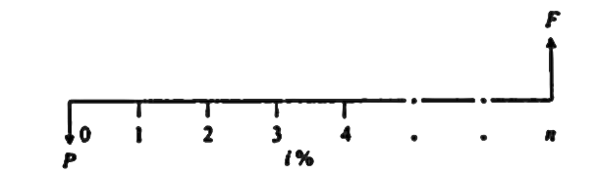
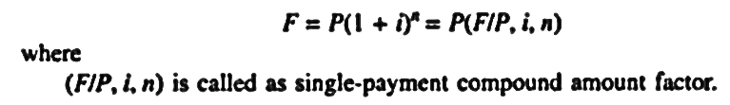
Types of Compound Interest Formulas
1. Single payment compound amount:
Here the objective is to find the single future sum (F) of initial payment P after n period at interest rate i % compounded every period.

Slide 6
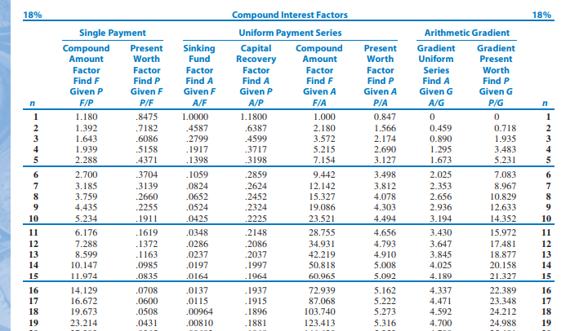

Slide 7
How much money will be accumulated in 25 years if Rs. 2400 is deposited six years from now, and Rs. 3300 is deposited 8 years from now, at an interest rate of 18 % p.a.?

Slide 8
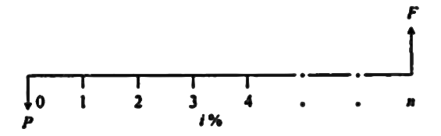
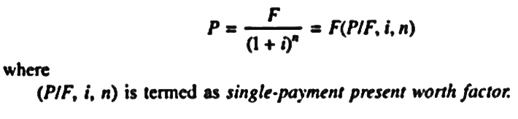
Types of Compound Interest Formulas
2. Single Payment Present Worth Amount:
Here the objective is to find the present worth amount (P) of a single future sum (F) which will be received after n periods at an interest rate of i% compounded at the end of every interest period.

Slide 9
How much must be invested now at 16% compounded annually so that $1,811 can be received 4 years hence?

Slide 10
To find i:
Suppose you buy a share of stock for $20 and sell it for $40. If this happens within a year then your i = 100%. If it takes 5 years, what is the rate of return on your investment?

Slide 11
To find n:
You just purchased 100 shares of Citi group stock at $60/ share. You will sell the stock when market price is doubled. If you expect the stock price to increase 20% per year, how long do you anticipate waiting before selling the stock?

Slide 12
Wilson technology, wishes to set aside money now to invest over the next 4 years to use to automate its customer service department. The company can earn an interest at 10% on the lump sum deposited now and it wishes to withdraw the money in the following increments. • Year 1: $25,000 to purchase a computer • Year 2: $3000 to purchase additional hardware • Year 3: No expenses • Year 4: $5000 to purchase s/w upgrades. How much money must be deposited now to cover anticipated expenses over next 4 years?

Slide 13
Practice exercises
TVM at different points in time
Varying interest rates

Slide 14
Equal payment series

Slide 15
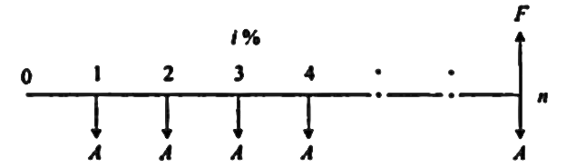
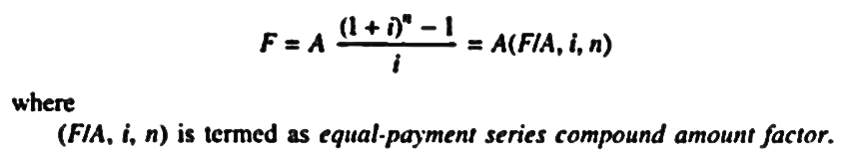
Types of Compound Interest Formulas
1. Equal Payment Series Compound Amount:
Here the objective is to find the future worth of n equal payments which are made at the end of every interest period till the end of nth interest period at an interest rate of i % compounded at the end of each interest period.

Slide 16
Suppose you make an annual contribution of $3000 to your savings account at the end of each year for 10 years. If the account earns 7% interest annually, how much can be withdrawn at the end of 10 years?
Suppose the ten deposits were made at the beginning of each period, what is the balance at the end of period 10?

Slide 17
Consider 3 investment plans for an individual who just celebrated his 24th birthday. (i= 8%).
Invest $2000 per year for first 10 years. At the end of 10 years make no further investments, but reinvest the amount for next 30 years.
Do nothing for first 10 years. Then start investing $2000/year for the next 30 years.
Invest $2000/ year for the entire 40 years.
Note that all investments are made at the birthday of each year, the first deposit will be made on 25th birthday (n=1).
Calculate the balance as on 64th birthday.

Slide 18
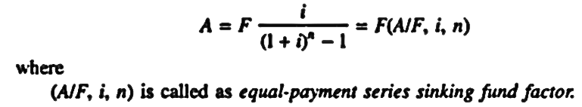
Types of Compound Interest Formulas
2. Equal Payment Series Sinking Fund:
Here the objective is to find the equal amount (A) that should be deposited at the end of every interest period for n period to realize a future sum (F) at the end of nth period at an interest rate of i %.

Slide 19
A small firm requires $200,000, 8 years from now, for the upgrade of its plant. It is willing to invest an equal amount per year from 1 to 3 (EOY 1 to EOY3), and double the instalment amount from years 5 to 7 (EOY 5 to EOY7). what are the investments to be made? Assume an interest rate of 10 percent per year.

Slide 20
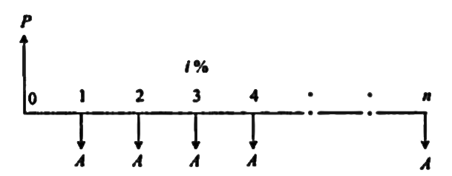
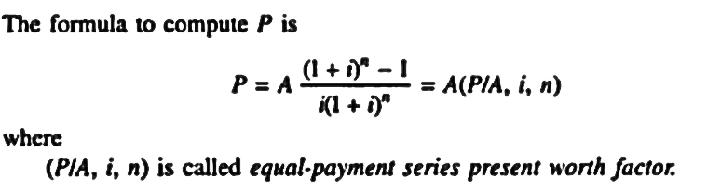
Types of Compound Interest Formulas
5. Equal Payment Series Present Worth:
Objective is to the find present worth of an equal payment made at end of every interest period for n periods.

Slide 21
Solved Problems
Determine the amount P that you should deposit into an account 2 years from now, in order to be able to withdraw Rs. 4000/- per year for 5 years starting 3 years from now, at an interest rate of 15% per year ? Also find the investment’s current value?
P = ? ; i = 15% ; n=5 ; A= 4000 ;
Notation: P= A(P/A, i, n) = 4000 * (P/A, 15, 5) = 4000 * (3.3522) = Rs 13408.80/-
P1 = P (P/F, 15%, 2) = Rs13408.8 *0.7561 = Rs10138.39
i= 15% n=5 years
4000
4000
4000
4000
4000
0
1
2
3
4
5
6
7
8
P1
P

Slide 22
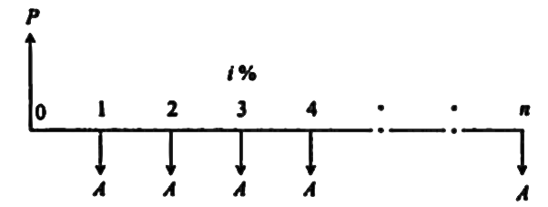
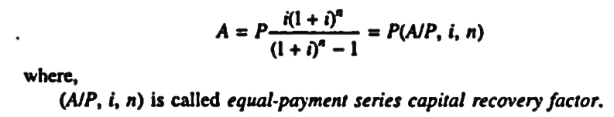
Types of Compound Interest Formulas
6. Equal Payment Series Capital Recovery Amount:
Objective of this mode of investment is to find the annual equivalent amount (A) which is to be recovered at the end of every interest period for n interest periods for a loan (P) which is sanctioned now at an interest rate i% compounded every period.

Slide 23
Q10 in question sheet
Biogen Co., has borrowed $250,000 to purchase lab equipment for gene splicing at an interest rate of 8% and is to be repaid in equal instalments over next 6years.
I. Compute the annual instalment.
II. Suppose Bio Gen wants to negotiate with the bank to defer the first loan payment until the end of year 2 (but still desires to pay the 6 instalments at 8% interest) What should be the annual instalment (deferred annuity)

Slide 24
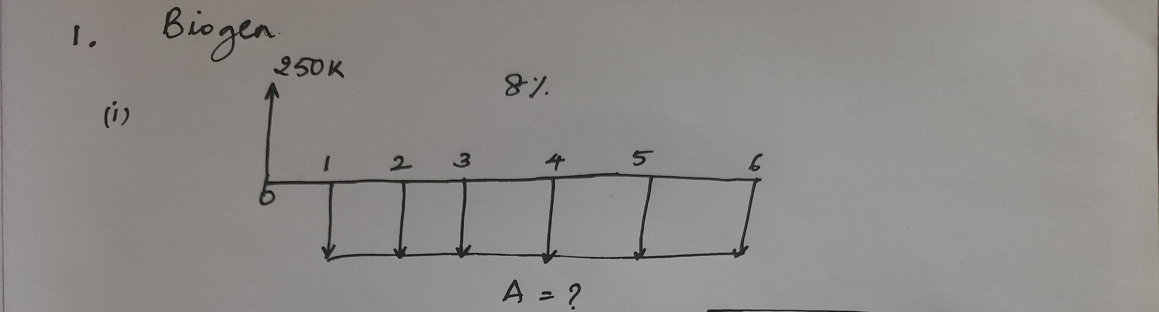
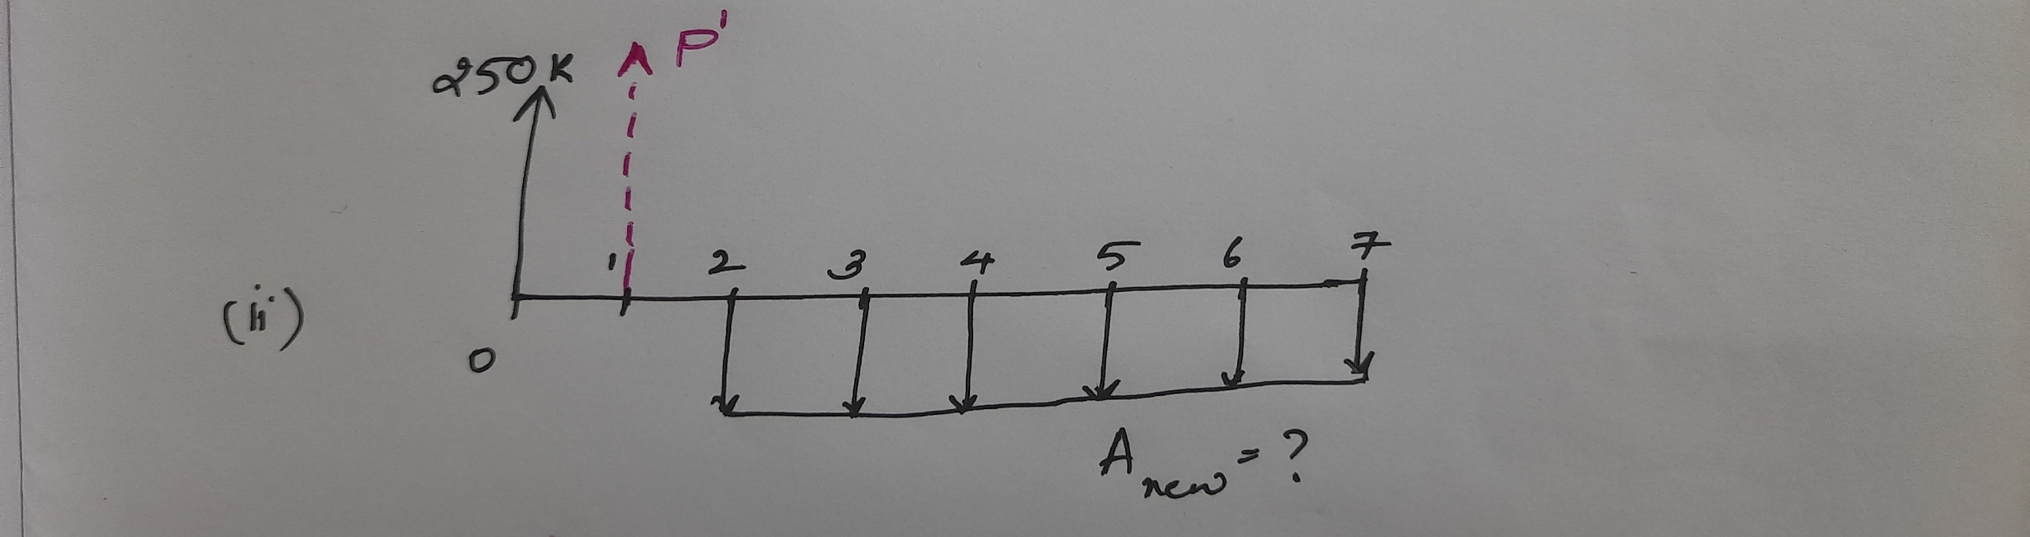

Slide 25
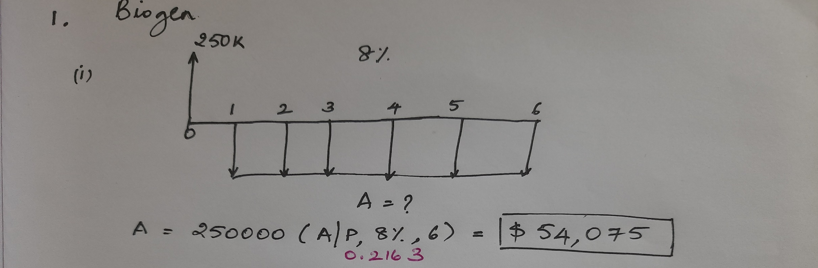

Slide 26
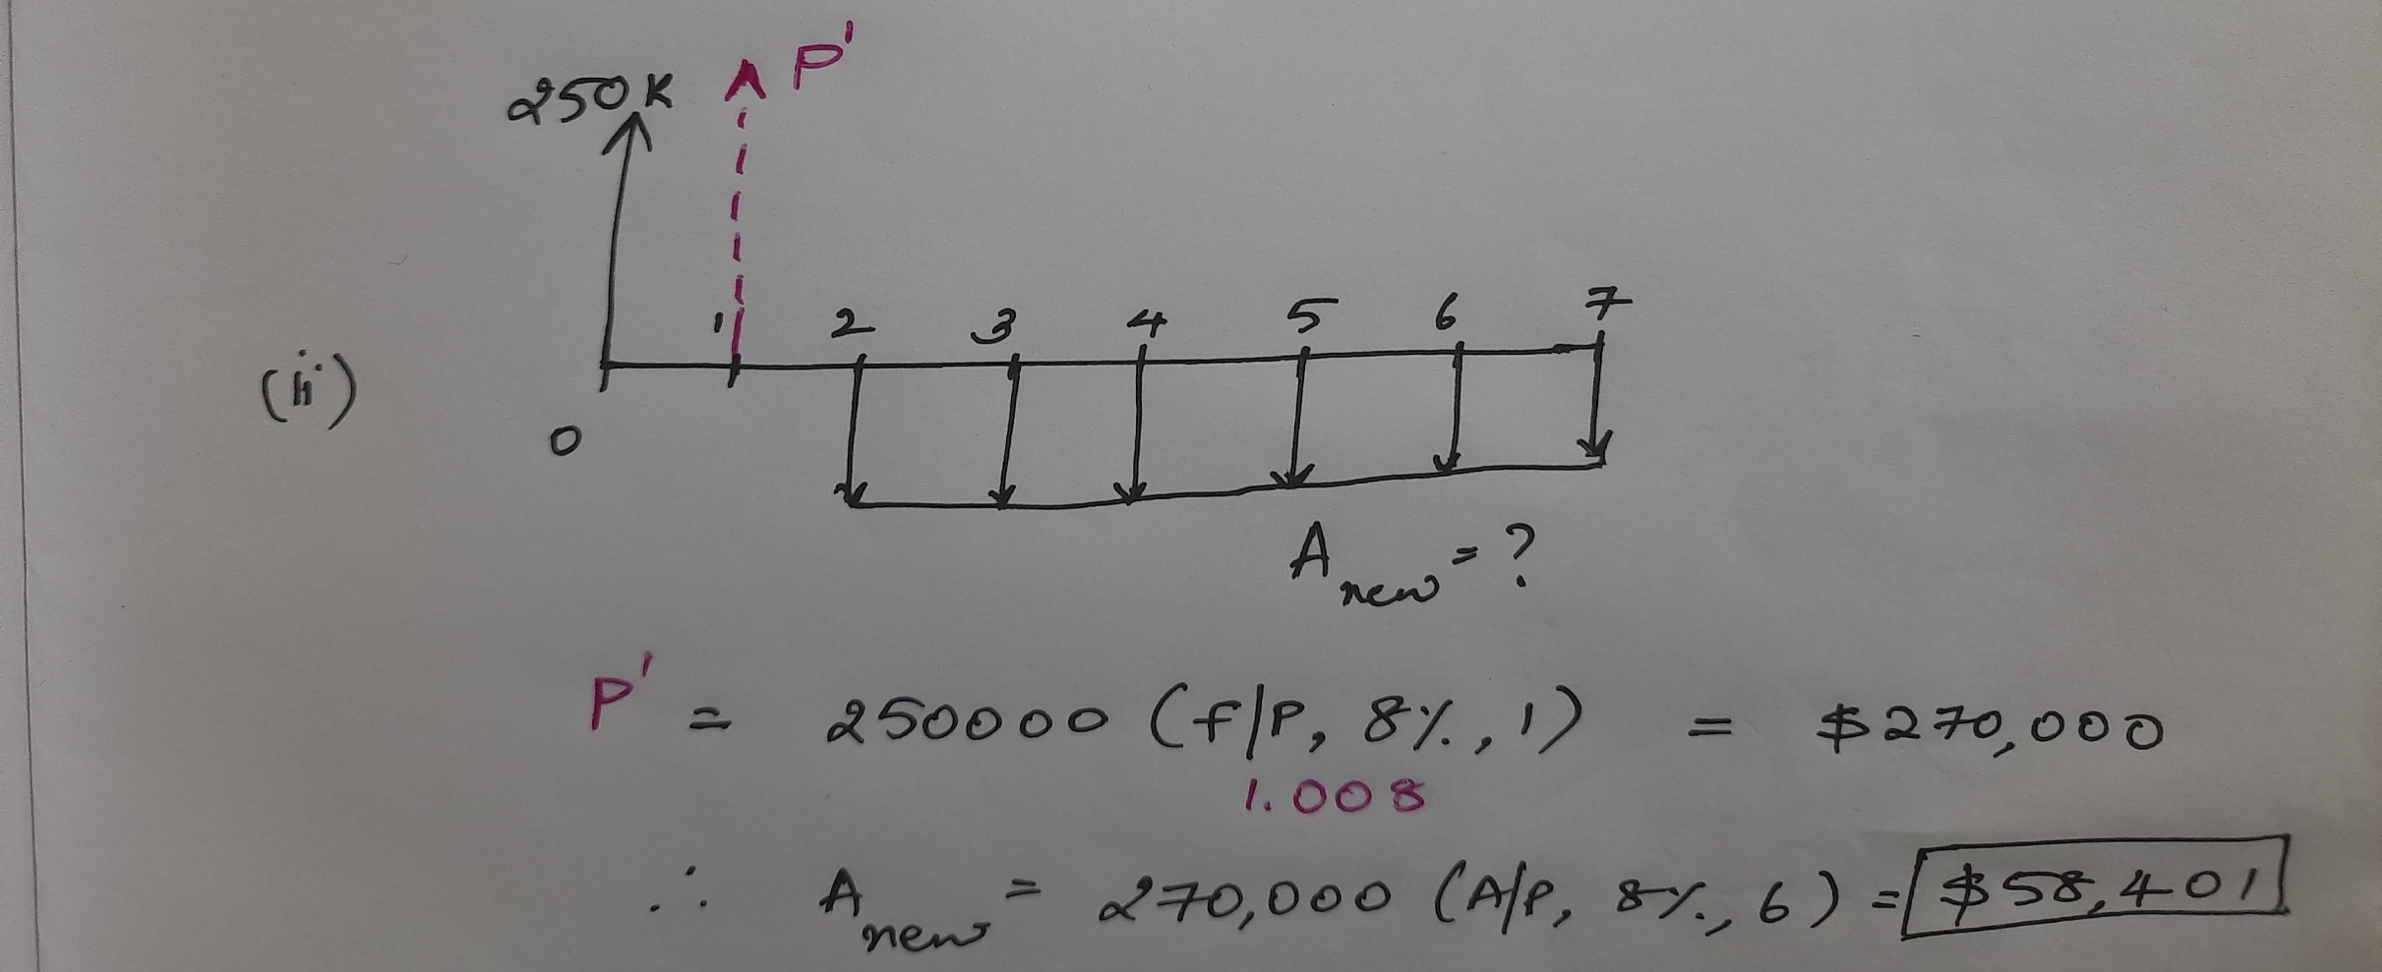

Slide 27
A couple with a new born daughter wants to save for their child’s college expenses in advance. The couple can establish a college fund that pays 7% annual interest. Assuming the child enters college at age 18, the parents estimate that an amount of $40,000 per year will be required to support the child’s college expenses for 4 years. Determine the equal annual amounts the couple must save until they send their child to college.

Slide 28
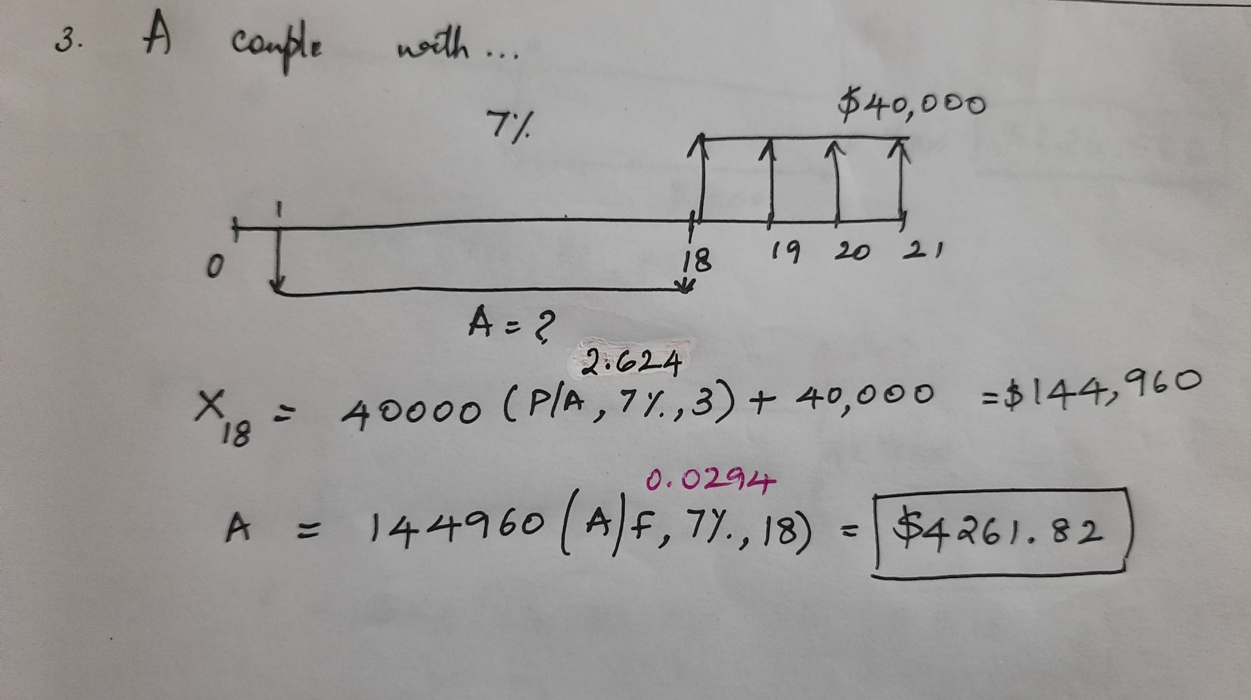

Slide 29
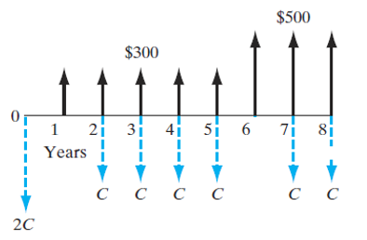
Unknown C
Consider the cash flow shown below. What value of C makes the inflow series equivalent to the outflow series at an interest rate of 10%?

Slide 30
Henry Cisco is planning to make two deposits: $25,000 now and $30,000 at the end of year 6. He wants to withdraw C for the first six years and (C+ $1,000) each year for the next six years. Determine the value of C if the deposits earn 10% interest compounded annually.

Slide 31
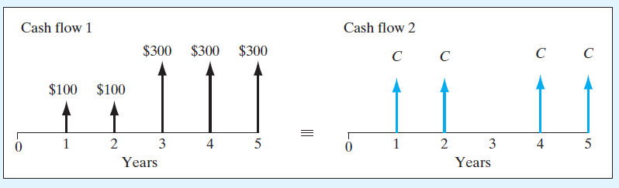


The two cash flows are equivalent at an interest rate of 12% compounded annually. Determine the unknown value C.

Slide 32
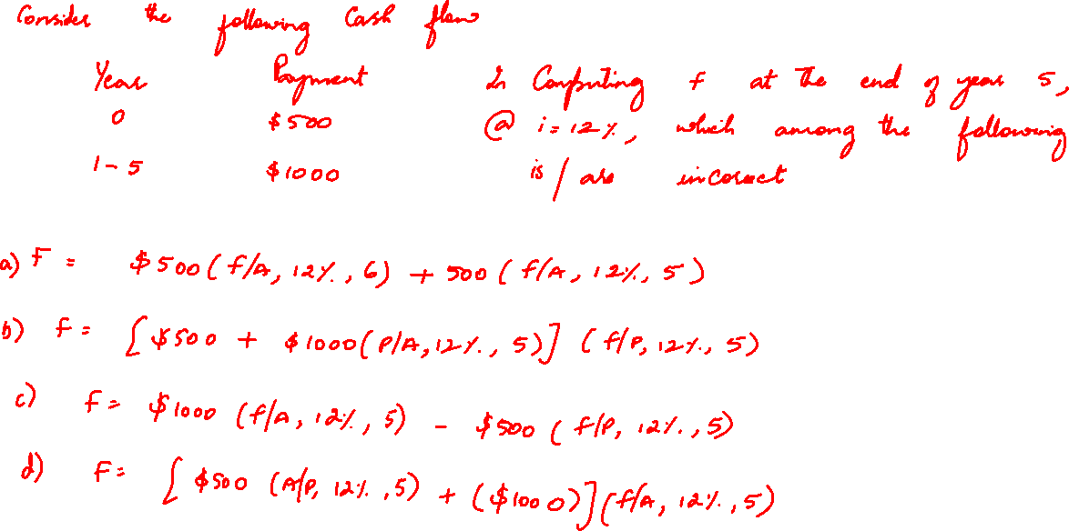

Slide 33
UNIFORM GRADIENT SERIES
OR
LINEAR GRADIENT SERIES
OR
ARITHMETIC GRADIENT SERIES

Slide 34
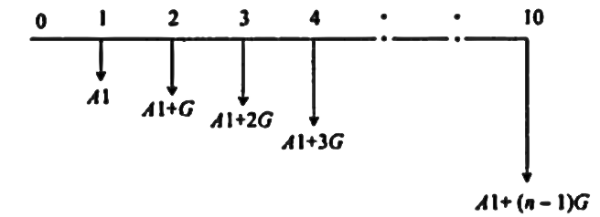
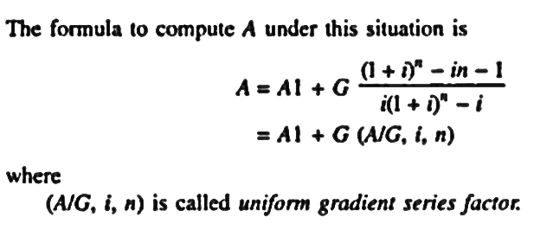
Types of Compound Interest Formulas
Uniform Gradient Series Annual Equivalent Amount:
The objective of this mode of investment is to find the annual equivalent mode of a series with an amount A₁ at the end of first year and with an equal increment (G) at the end of each of the following n-1 years with the interest rate i % compounded annually.

Slide 35
1. John and Barbara have just opened two savings accounts at their credit union. The accounts earn 10% annual interest. John wants to deposit $1000 in his account at the end of the first year from now and increase this amount by $300 for each of the next five years. Barbara wants to deposit an equal annual deposit each year for the next six years. What should be Barbara’s annual deposit so that the two accounts will have equal balances at the end of six years?

Slide 36
3. Suppose that you make a series of annual deposits into a bank account that pays 10% interest. The initial deposit at the end of 1st year from now is Rs.1,200.The deposit amount declines by Rs.200 in each of the next 4years. How much would you have immediately after 5th deposit?

Slide 37
2. A man is purchasing a small garden tractor. There will be no maintenance cost during the first 2 years because the tractor is sold with 2 years free maintenance. For the third year, the maintenance is estimated at $20. In subsequent years the maintenance cost will increase by $20 per year (i.e., fourth-year maintenance will be $40, fifth-year $60, etc.). How much would need to be set aside now at 8% interest to pay the maintenance costs on the tractor for the first 6 years of ownership?

Slide 38
The maintenance foreman of a plant reviewing his records found that a large press had the following maintenance cost record estimated by a colleague:
5 years ago $ 600
4 years ago $ 700
3 years ago $ 800
2 years ago $ 900
Last year $ 1000
After consulting with a specialist, he updated the preventive maintenance schedule to include 5 more years of its useful life. He believes that this year maintenance will be $900 and will decrease $100 a year in each of the following 4 years. If his estimate of the future is correct, what will be the equivalent uniform annual maintenance cost over the 10-year period? Assume interest at 8%.

Slide 39
UNIFORM GRADIENT SERIES
OR
LINEAR GRADIENT SERIES
OR
ARITHMETIC GRADIENT SERIES

Slide 40
Types of Compound Interest Formulas
Uniform Gradient Series Annual Equivalent Amount:
The objective of this mode of investment is to find the annual equivalent mode of a series with an amount A₁ at the end of first year and with an equal increment (G) at the end of each of the following n-1 years with the interest rate i % compounded annually.

Slide 41
1. John and Barbara have just opened two savings accounts at their credit union. The accounts earn 10% annual interest. John wants to deposit $1000 in his account at the end of the first year from now and increase this amount by $300 for each of the next five years. Barbara wants to deposit an equal annual deposit each year for the next six years. What should be Barbara’s annual deposit so that the two accounts will have equal balances at the end of six years?

Slide 42
Suppose that you make a series of annual deposits into a bank account that pays 10% interest. The initial deposit at the end of 1st year from now is Rs.1,200.The deposit amount declines by Rs.200 in each of the next 4years. How much would you have immediately after 5th deposit?

Slide 43
A man is purchasing a small garden tractor. There will be no maintenance cost during the first 2 years because the tractor is sold with 2 years free maintenance. For the third year, the maintenance is estimated at $20. In subsequent years the maintenance cost will increase by $20 per year (i.e., fourth-year maintenance will be $40, fifth-year $60, etc.). How much would need to be set aside now at 8% interest to pay the maintenance costs on the tractor for the first 6 years of ownership?

Slide 44
The maintenance foreman of a plant in reviewing his records found that a large press had the following maintenance cost record:
5 years ago $ 600
4 years ago $ 700
3 years ago $ 800
2 years ago $ 900
Last year $ 1000
After consulting with a specialist, he estimated the preventive maintenance schedule for the next 5 years. He believes that this year maintenance will be $900 and will decrease $100 a year in each of the following 4 years. If his estimate of the future is correct, what will be the equivalent uniform annual maintenance cost for the 10-year period? Assume interest at 8%.

